Slide 1
ENGG104 Electrical Systems
Introductory Circuit Analysis, Boylestad, 12th Ed
Attribution Nidhal Abdulaziz
Lecture 1

Slide 2
Electrical Systems- Introduction
Why learn Circuit theory and devices?
Applications – many!!!
Concepts & Methodologies– simple to complex!!!

Slide 3
A brief Histroy
FIG. 1.2 Time charts: (a) long-range; (b) expanded.

Slide 4
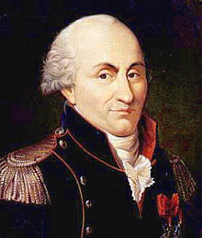
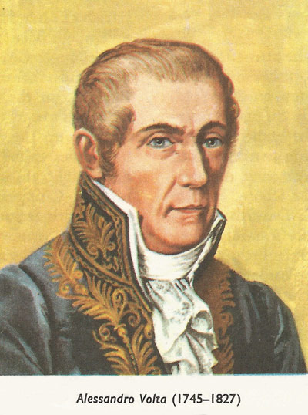
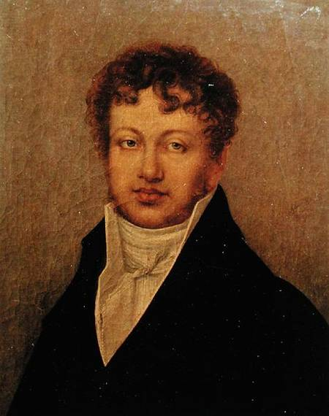
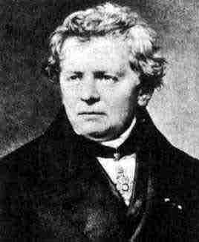
Coulomb, Volta, Ampere and Ohm
Coulomb
Volta
Ampere
Ohm

Slide 5
Electric Circuit Fundamentals
Electric Charge
Current and Voltage
Voltage sources
Resistance and Conductance
Ohm’s Law

Slide 6
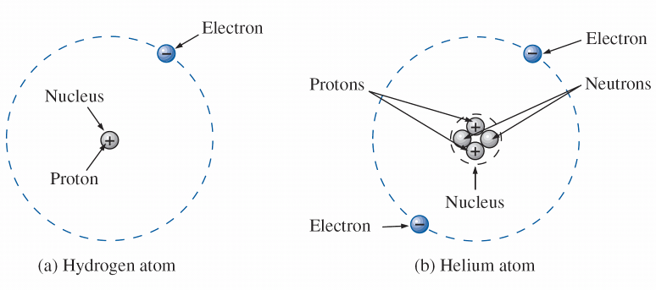
The Structure of the Atom
FIG. 2.1 Hydrogen and helium atoms.

Slide 7
The structure of the Copper atom
FIG. 2.2 The atomic structure of copper.

Slide 8
Electric Charge
Atoms contain a nucleus and surrounding electrons
The nucleus contains protons, which have a positive charge
Surrounding the nucleus are electrons, which have a negative charge
In some materials, particularly metals such as copper, one or more electrons have only a loose bond with the nucleus
These electrons can hence easily move, thereby creating a flow of electric charge
The unit used for measuring electric charge is the “Coulomb”
1 Coulomb is the combined charge arising form 6.242 x 10¹⁸ electrons

Slide 9
Voltage
If we separate the 29th electron in Fig. 2.2 from the rest of the atomic structure of copper by a dashed line as shown in Fig. 2.4(a), we create regions that have a net positive and negative charge as shown in Fig. 2.4(b) and (c).
FIG. 2.4 Defining the positive ion.

Slide 10
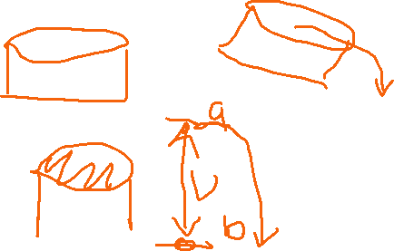

Voltage
In general, every source of voltage is established by simply creating a separation of positive and negative charges.

Slide 11




Voltage
A potential difference of 1 volt (V) exists between 2 points if 1 joule (J) of energy is released in moving 1 Coulomb (C) of charge

Slide 12
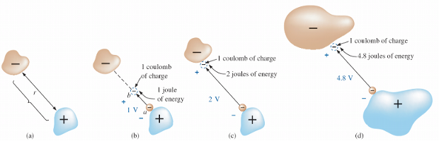
















Voltage
FIG. 2.5 Defining the voltage between two points.

Slide 13

Voltage – Potential Difference
Since the potential energy associated with a body is defined by its position, the term potential is often applied to define voltage levels.
For example, the difference in potential is 4 V between the two points, or the potential difference between a point and ground is 12 V, and so on.

Slide 14
Voltage
Hence a 9 volt (9V) battery will provide more energy than a 1.5 V battery, assuming that the same current is drawn from each one
Example 1: Find the potential difference if 60J of energy is expended by a charge of 20C.

Slide 15


Electric Current
In a conductor, such as copper wire, a very large number of “free” electrons are in constant motion
These free electrons have been dislodged from particular atoms
As this motion is random, there is no net flow of charge through the wire, unless an external force is applied
This “external force” may be a battery, which provides a positive charge at one end of a wire, and a negative charge at the other end
As a result, electrons begin to flow through the wire, towards the end with the positive charge

Slide 16
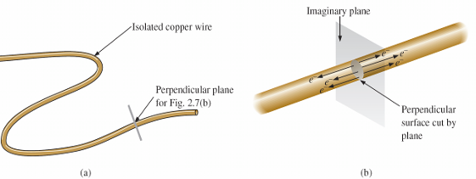
Current
FIG. 2.7 There is motion of free carriers in an isolated piece of copper wire, but the flow of charge fails to have a particular direction.

Slide 17
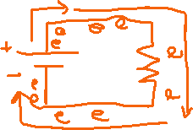
Current
FIG. 2.8 Motion of negatively charged electrons in a copper wire when placed across battery terminals with a difference in potential of volts (V).

Slide 18
Current
The applied voltage is the starting mechanism—the current is a reaction to the applied voltage
the applied voltage (or potential difference) in an electrical/electronics system is the “pressure” to set the system in motion, and the current is the reaction to that pressure.
FIG. 2.9 Basic electric circuit.

Slide 19


Electric Current
This flow of electrons is known as an electric current
Note that the direction of current flow is actually opposite to the direction of electron flow by convention
A current of 1 Ampere, or 1 A means a charge flow of 1 coulomb/sec

Slide 20
Example
If the charge flowing is equal to 0.16C every 64ms, what is the current flow in Amperes?
How many seconds are required for 4x10¹⁶ electrons to pass if current flow is 5mA

Slide 21




DC Voltage Sources
A “Direct Current”, or DC voltage source provides a constant voltage between two terminals
A battery is a common DC voltage source
The circuit symbol for a voltage source is shown opposite
Note that the longer line indicates the “positive” terminal, i.e. with the higher voltage
An external connection between the two terminals will cause a current to flow between them
In theory, a DC voltage source provides a constant voltage
However, for most voltage sources, the voltage will drop as the current increases. Why?
The internal resistance of battery will consume some potential difference so the received voltage will be smaller.
The higher the current, the higher the drop

Slide 22
Voltage sources
In general, dc voltage sources can be divided into three basic types:
Batteries (chemical action or solar energy)
Generators (electromechanical), and
Power supplies (rectification—a conversion process to be described in your electronics courses)

Slide 23
Batteries
Primary Cells (Non-rechargeable)
Secondary Cells (Rechargeable)
Lead-Acid
Nickel–Metal Hydride (NiMH)
Lithium-ion (Li-ion)

Slide 24
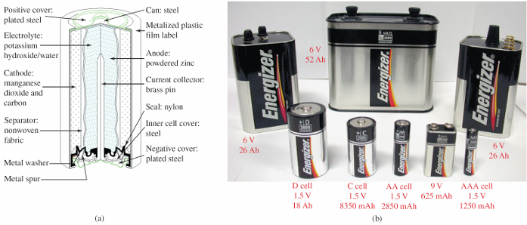
Non rechargeable Primary cell
FIG. 2.12 Alkaline primary cell: (a) Cutaway of cylindrical Energizer® cell; (b) various types of Eveready Energizer® primary cells.

Slide 25
Rechargeable
FIG. 2.14 Maintenance-free 12 V (actually 12.6 V) lead-acid battery.

Slide 26


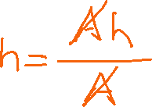
Batteries as DC sources
The capacity of a battery is normally given in “Ampere-hours” in addition to their voltage
For example, an 8 Ampere-hour 12V battery will provide the following
A current of 8 A, at 12V, for 1 hour
If at 12V, I use 8A current, after 1 hour the battery will be dead
A current of 4 A, at 12V, for 2 hours etc

Slide 27
Other sources – Solar cell
FIG. 2.17 Solar System: (a) panels on roof of garage; (b) system operation.

Slide 28
Other Sources – DC generator
The dc generator is quite different from the battery, both in construction and in mode of operation.
When the shaft of the generator is rotating at the nameplate speed due to the applied torque of some external source of mechanical power, a voltage of rated value appears across the external terminals.
The terminal voltage and power-handling capabilities of the dc generator are typically higher than those of most batteries, and its lifetime is determined only by its construction.

Slide 29
DC generator
FIG. 2.18 dc generator.

Slide 30
CONDUCTORS AND INSULATORS
Different wires placed across the same two battery terminals allow different amounts of charge to flow between the terminals.
Many factors, such as the density, mobility, and stability characteristics of a material, account for these variations in charge flow.
In general, however, conductors are those materials that permit a generous flow of electrons with very little external force (voltage) applied.
In addition, good conductors typically have only one electron in the valence (most distant from the nucleus) ring.

Slide 31
CONDUCTORS AND INSULATORS
TABLE 2.1 Relative conductivity of various materials

Slide 32
CONDUCTORS AND INSULATORS
FIG. 2.26 Various types of insulators and their applications. (a) Fi-Shock extender insulator; (b) Fi-Shock corner insulator; (c) Fi-Shock screw-in post insulator.

Slide 33
CONDUCTORS AND INSULATORS
TABLE 2.2 Breakdown strength of some common insulators.

Slide 34
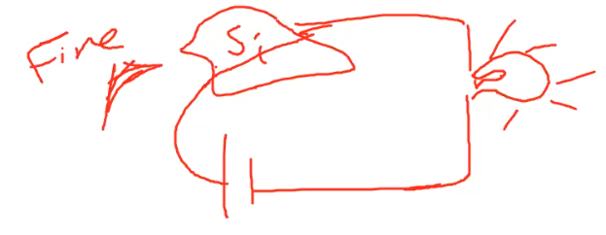
SEMICONDUCTORS
Semiconductors are a specific group of elements that exhibit characteristics between those of insulators and those of conductors.
Semiconductor materials typically have four electrons in the outermost valence ring.

Slide 35
Resistance
When a current flows through a material, there will be some opposition to this flow
This opposition is known as resistance
The unit used to describe resistance is the “ohm”, written as Ω
Hence a resistance of 1000 ohms is written as 1000 Ω, or 1 kΩ
To overcome resistance, and hence allow current to flow through a material, a potential difference (or voltage) must be applied

Slide 36


Resistors: Wire
Copper wire is the most commonly used conductor
The resistance of a piece of wire (or any conductor) is determined by
the length
the temperature
cross sectional area (i.e. how wide it is)
the material it is made from (e.g. copper)

Slide 37

Resistors: Wire
Combining these factors, the resistance (R) of a conductor is given as,
l is the length (in centimeters)
A is the cross sectional area (cm²)
ρ is the “resistivity”, in ohm centimetres (e.g. for copper, ρ = 1.723 x 10⁻⁶ Ω cm)
ΔT is the change in temperature from 20º C
α₂₀ is the temperature coefficient of the conductor at 20º C (α₂₀ is 0.00393 for copper - positive)

Slide 38
Example: Resistance
What is the resistance of a 100m length of copper wire that has a diameter of 1cm? Resistivity of copper is 1.68x10⁻⁸ Ω.m

Slide 39
Example: Resistance continued
How about Silicon (resistivity = 6.4x10²) and Rubber (Resistivity = 10¹³)? Use the same area and length in the previous example.

Slide 40


Standard Resistors
A resistor is a device commonly used in electric circuits, to establish a specified resistance between two points
The symbol for a resistor is shown opposite
The most commonly used resistors are made from a composition of carbon
Other materials commonly used for resistors are wire and metal film

Slide 41
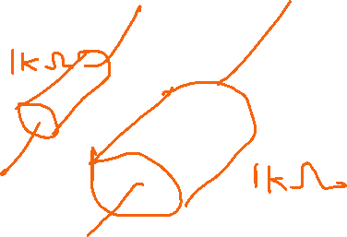
Standard Resistors
In addition to the nominal resistance value, a key resistor parameter is the power rating
This is the maximum power which the resistor can handle without being damaged
Resistors used in electronic circuits commonly have a power rating of ½ Watt

Slide 42
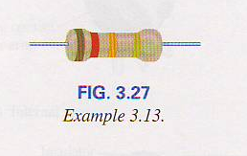










Resistor Colour Coding
Resistors are too small to have their values written on to them using numbers
Instead, colour bands are used, as follows
Bands 1-3 indicate the resistor value, with band 3 being the multiplier
The multiplier is the power of 10 applied to the number given by the first 2 bands, to obtain the resistance
Band 4 is the tolerance, i.e. how close the resistor will be to the nominal value
Band 5 is the % failure per 1000 hours of use
Bands 1-3 | Band 3 | Band 4 | Band 5
0 Black | 0.1 Gold | 5% Gold | 1% Brown
1 Brown | 0.01 Silver | 10% Silver | 0.1% Red
2 Red |  | 20% No band | 0.01% Orange
3 Orange |  |  | 0.0001% Yellow
4 Yellow
5 Green
6 Blue
7 Violet
8 Grey
9 White

Slide 43
Resistor Standard Values
You would expect resistors to come in values such as 12, 20, 50, 100 ohms
However, standard resistor values are arranged as follows (for 10% resistors between 10 and 100 ohms)
10Ω, 15 Ω, 18 Ω , 22 Ω, 27 Ω, 33Ω, 39 Ω, 47 Ω, 56 Ω, 68 Ω, 82 Ω, 100 Ω

Slide 44
Resistor Standard Values
The same value ranges are used for resistors between 100 and 1000 Ω, 1000 and 10000 Ω, and so on
The idea behind these values is that by matching resistors (i.e. by sorting through the range of values available for resistors with a given nominal value and tolerance), any resistance value may in principle be achieved
47±20%
56.4
80
100±20%
54.4
68±20%
81.6

Slide 45



Conductance
Resistance measures the opposition to current flow of a given material
Conductance is the opposite of this, and indicates how well a material will conduct electricity
Hence conductance (expressed with the symbol G) is the opposite of resistance
i.e. G = 1/R

Slide 46

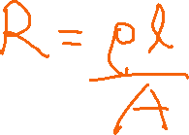


Conductance
The unit for conductance is Siemens (S)
The equation for conductance (inverse of resistance) of a wire is G = A/ρl

Slide 47
AMMETERS AND VOLTMETERS
It is important to be able to measure the current and voltage levels of an operating electrical system to check its operation, isolate malfunctions, and investigate effects impossible to predict on paper.
As the names imply, ammeters are used to measure current levels; voltmeters, the potential difference between two points.
If the current levels are usually of the order of milliamperes, the instrument will typically be referred to as a milliammeter, and if the current levels are in the microampere range, as a microammeter.

Slide 48
AMMETERS AND VOLTMETERS
FIG. 2.27 Voltmeter connection for an up-scale (+) reading.

Slide 49
AMMETERS AND VOLTMETERS
FIG. 2.28 Ammeter connection for an up-scale (+) reading.

Slide 50
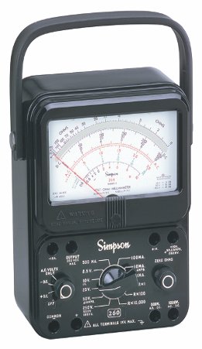
AMMETERS AND VOLTMETERS
FIG. 2.29 Volt-ohm-milliammeter (VOM) analog meter.

Slide 51
AMMETERS AND VOLTMETERS
FIG. 2.30 Digital multimeter (DMM).

Slide 52
Ohm’s Law
Earlier we indicated that the current through a conductor was determined by the potential difference, or voltage between the two ends
Hence increasing the voltage across a conductor, or resistor, will increase the current through it.

Slide 53
Ohm’s Law
This leads to a simple but powerful law, known as Ohm’s Law, which relates voltage (V), resistance (R) and current (I) as follows:
I = V/R, i.e. the current through a resistor is directly proportional to the voltage across it, and inversely proportion to the resistance
V = IR, the voltage across a resistor is directly proportional to the current and the resistance

Slide 54
Example: Ohms Law
Determine the current when a 9 V battery is applied across a 2.2 Ω resistor.

Slide 55
Open Circuits and Short Circuits
Having introduced voltage sources and resistors, we can now introduce simple circuits
The top circuit shows a 1 kΩ resistor connected across the terminals of a 12V voltage source
If we remove the resistor, and replace it with a direct connection between the terminals (as shown in the middle diagram), then we have a “short circuit”
This will draw a very large current from the voltage source, potentially damaging it

Slide 56
Open Circuits and Short Circuits
If we simply remove the resistor, then we have an “open circuit”, as shown in the bottom diagram
As there is no connection between the voltage source terminals, there will be no current flow

Slide 57


Lecture 1 summary
Charge (Coulombs )
Separating positive and negative charges requires work to be done and creates a potential difference V (volts)= W(J)/Q(C)
Voltage difference ‘pushes’ electrons to move creating a current if a continuous path is present (a circuit) I(A)=Q(C)/t(sec)
Voltage source could be chemical or mechanical
Resistance is a measure of how easily electrons flow.
Relates voltage and current V=IR (ohms law)
No current flows in a branch of an open circuit

